Slide 1


Introduction to Optimization in Generic Algebraic Modeling System (GAMS)
26th June 2022
Presented by:
Dr. Muhammad Nurariffudin
Universiti Teknologi Malaysia (UTM)

Slide 2
Objectives of this workshop
To understand the concept of optimisation and its associated components
2) To formulate mathematical optimization problems based on manual and software approaches
3) To code the optimization model into an optimisation software, Generalised Algebraic Modeling System (GAMS)
4) To perform scenario analysis for the evaluation of variable renewable energy (vRE) and analyse the impact on microgrid power generation scheduling

Slide 3
Expected Outcomes
By the end of the course, the participant should be exposed to:
Fundamental concept of optimisation
Applications of optimization in various fields
Terminology in process optimization - objective function, decision variables and constraints
Formulating an Optimisation Model

Slide 4
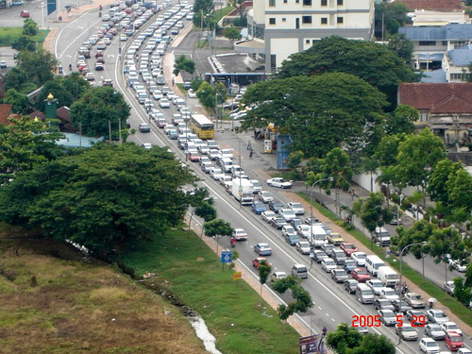
Why Optimisation
What can happen with poor or no appropriate optimisation models?
Very Costly Lessons!

Slide 5
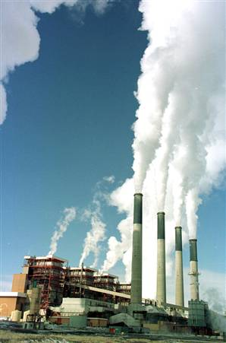
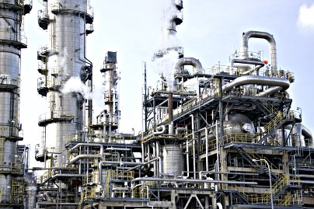
Application of Optimization Models
Example: A Utility Company
GHG
Heat Energy
(Steam)
Utility Plant
Chemical Plant
Fuel
But remember, there
are always trade-offs (good/bad)
to be considered

Slide 6
Application of Models
Example: A Utility Company
Cost
($/ton)
Fuel Cost +
Carbon Emission Cost
Utility Plant Cost
Optimum
Plant Size (ton/hr)

Slide 7
Why Optimization?
economic incentives:
maximise profit
minimise costs
maximise use of resources
minimise effort
technical incentives:
safer design and operating strategy
Better processing strategy
increased yield, conversion
optimum selectivity
minimum holdup
integral part of design and operation:
optimisation of process structure (synthesis)
optimisation of operation
technical/economic
control
environmental incentives:
Minimise carbon emission
Minimise environmental impact

Slide 8
Definition of Optimisation
The purpose of optimization is to maximize (or minimize) the value of a function (called objective function) subject to a number of restrictions (called constraints).
Finding the best solution to achieve the goal subject to a set of constraint

Slide 9
Key elements of Optimisation
Objective function
mathematical function to be minimised or maximised, related to the desired incentives by the company
Decision variables
variables that you can adjust or choose in order to minimize or maximize the objective function
variables can be:
Continuous, e.g. flowrates, concentration, temperature, pressure
Integers, eg. # of trays
Binary (either 0 or 1), eg. Select/not select - plant process flowsheet

Slide 10
Key elements of Optimisation
Constraints
Limitations or restrictions of decision variables.
can be physical, economic, policy, or environmental constraints
can be either equality constraints or inequality constraints
Parameters
variables that predefined by the users.
eg. Cost of the product

Slide 11
Equality Constraints
Equality constraints, h_{k} (x) = 0,
represent process restrictions:
Product purity must be exactly 98%
represent the process model:
The heat and material balance
Mole fraction summation equations
Equilibrium equations, etc.

Slide 12
Inequality Constraints
Inequality constraints, g_{j} (x) ≥ 0,
represent restrictions imposed by the designer and by nature.
Mole fraction flowrate must be greater than or equal to zero (no negative flowrates are allowed)
Pressure in a particular vessel cannot exceed an upper limit
A reactor volume cannot exceed the maximum currently manufactured
Production rates and product purities must all be greater than minimum values.

Slide 13
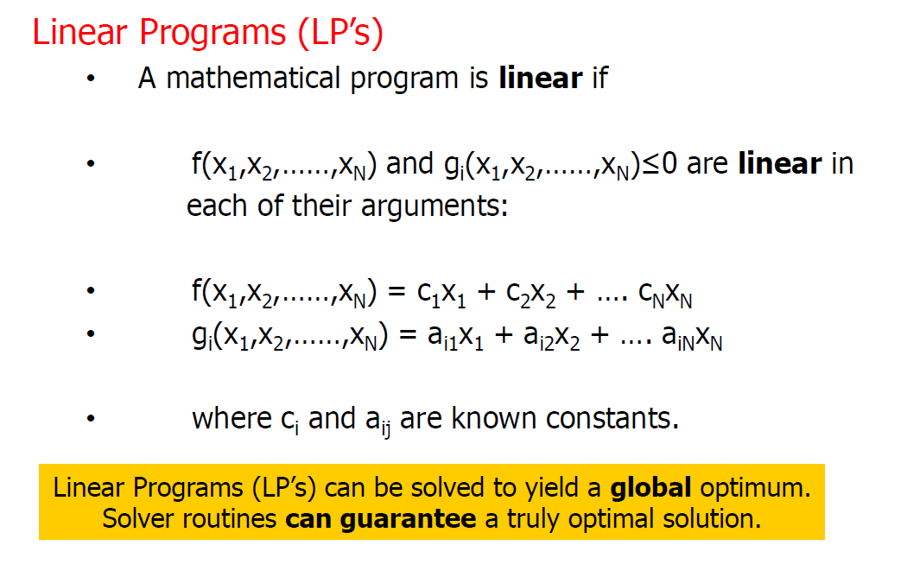
Classification of optimisation problem

Slide 14
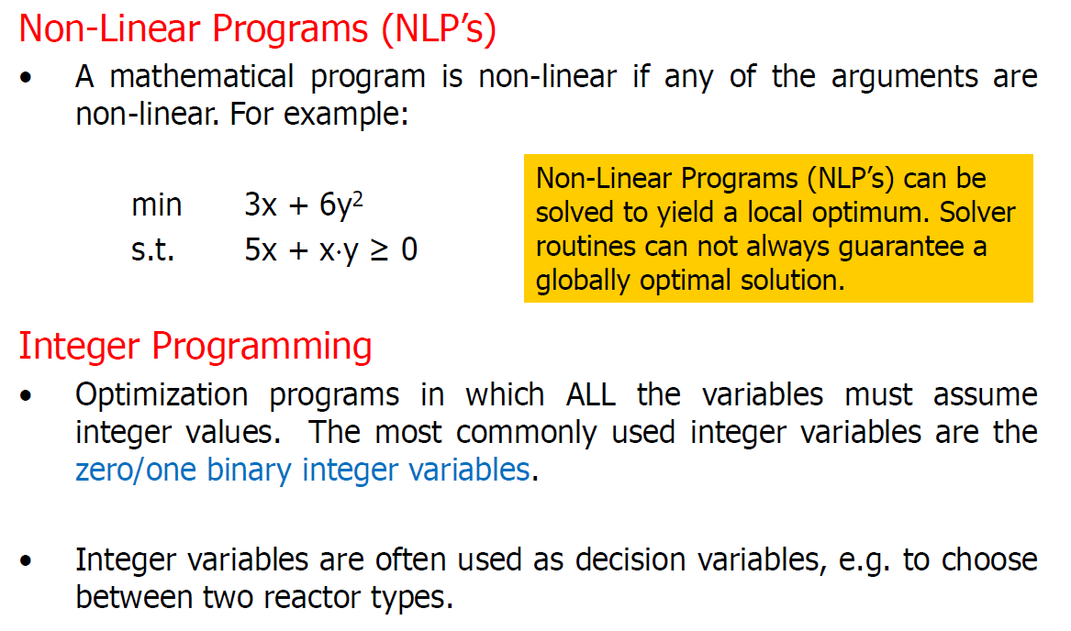
Classification of optimisation problem

Slide 15
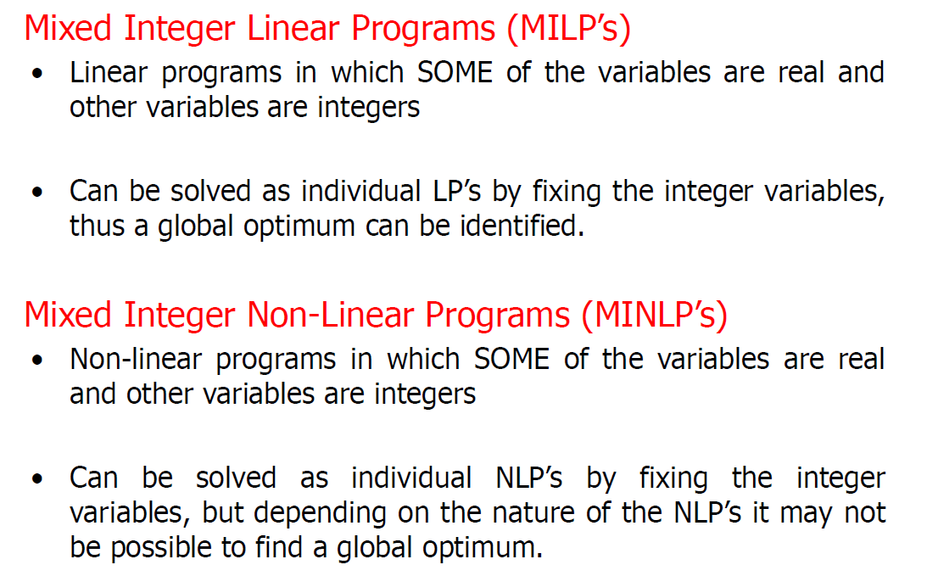
Classification of optimisation problem

Slide 16
Classification of optimisation problem

Slide 17
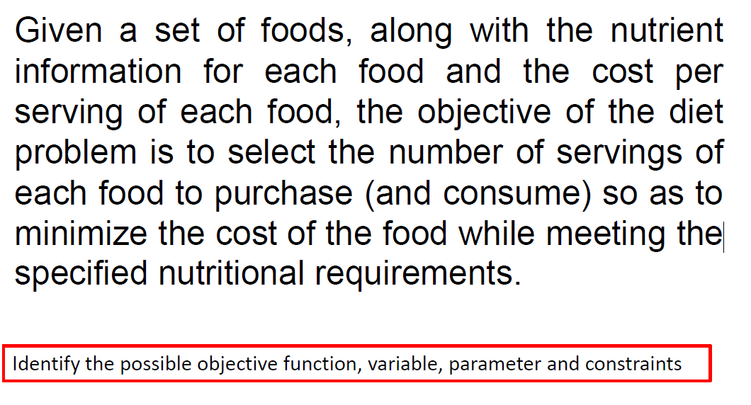
Example 1: Nutrient Requirements

Slide 18
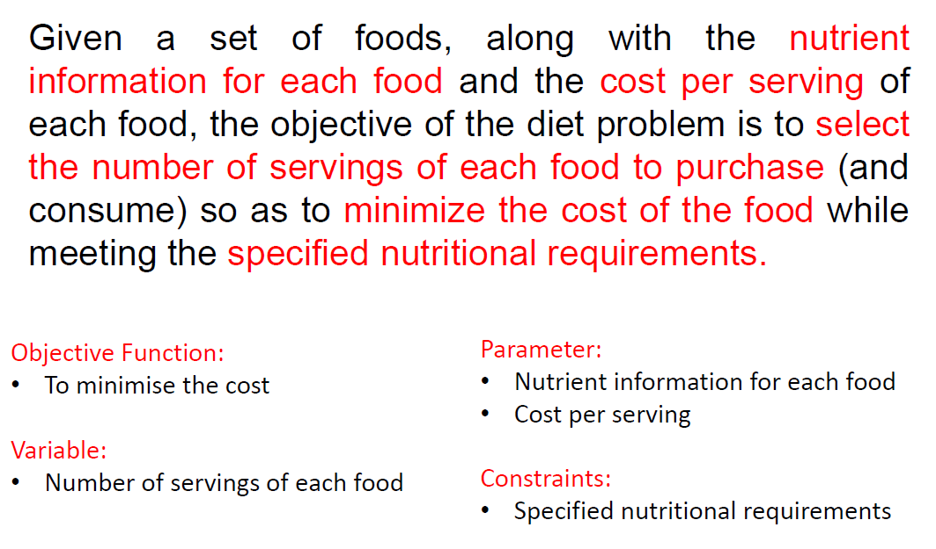
Solution to Example 1

Slide 19
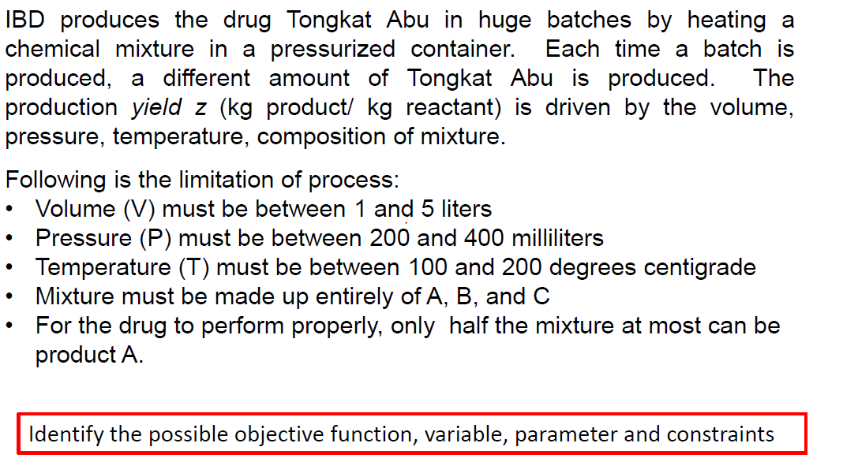
Example 2: Production of Tongkat Abu

Slide 20
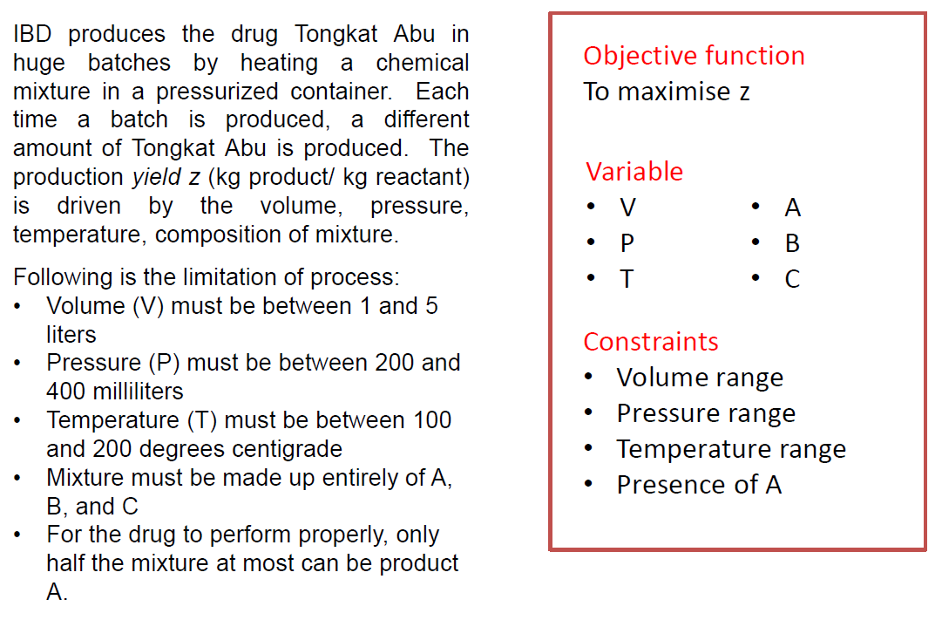
Solution to Example 2

Slide 21
Working Session: Solar Photovoltaic
Ahmad plan to install solar power generation in his house. By looking at the profile of hourly solar radiation and house electricity demand, identify
1. Objective Function
2. Decision variables
3. Parameter
4. Constraints

Slide 22
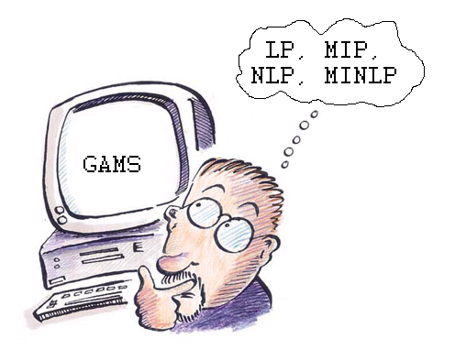
Generalized Algebraic
Modeling System
Generalized Algebraic Modeling Systems
GAMS is a high-level modeling system for mathematical programming
GAMS is a programming language that comes with
- a language compiler, and
- an integrated solver.
GAMS allows for the construction
and solution of large and complex
algebraic models

Slide 23
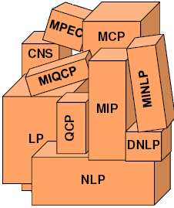
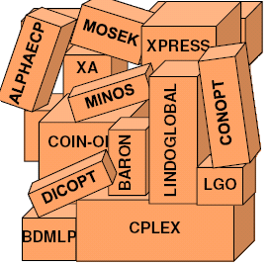
Generalized Algebraic Modeling System
GAMS system
A programming
language compiler
An integrated solver

Slide 24

Generic Algebraic Modeling System (GAMS)
GAMS is a high level modeling system for mathematical programming and optimization.
The GAMS modeling language allows modelers to quickly translate real world optimization problems into computer code.
The handling of different mathematical optimization problems (e.g., LP, MILP, NLP, MINLP, stochastic) is done through a variety of mathematical solvers (e.g., CPLEX, GUROBI, CBC, BARON) that translate the formulations into results.
The latest GAMS version offers two software platforms, namely GAMS Studio and GAMS IDE.
GAMS IDE is traditional platform used since the early days of GAMS application. GAMS Studio is a more user friendly platform as an alternative to GAMS IDE. In GAMS Studio, advanced functionality can be accessed, namely GAMS MIRO for web-based user interface and GAMS Engine for running large-scale models and scenarios.
GAMS Studio
GAMS IDE

Slide 25
General GAMS Structure
GAMS inputs
SETS
VARIABLES
PARAMETERS
EQUATION
MODEL
SOLVE

Slide 26
General GAMS Structure
GAMS Inputs
SETS
- Declaration
- Assignment of members
DATA (PARAMETERS, SCALARS, TABLES)
- Declaration
- Assignment of values
VARIABLES
- Declaration
- Assignment of types
- Assignment of bounds (optional)
- Assignment of initial values (optional)

Slide 27
Important Syntax Features of GAMS
Sets
Indices related to the algebraic representation of the model. Often used to categorize data and variables that have similar representation.
Example :
Hours in a day - 1am, 2am, 3am, 4am, 5am, 6am, 7am, 8am, 9am, 10am, 11am, 12am, 1pm, ………..
Types of fuels - Coal, oil, gas, biomass, solar, wind
Example syntax:

Slide 28
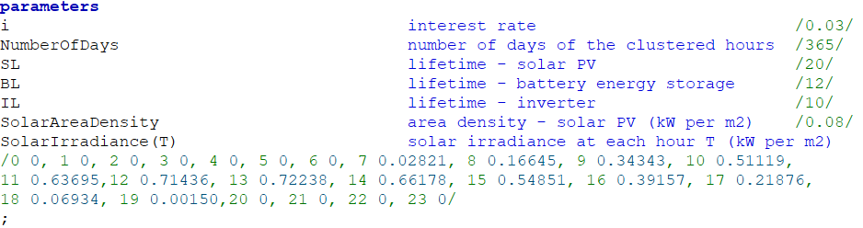
Important Syntax Features of GAMS
Parameters
Parameters are the data that needs to be inputted in GAMS in order for the model to work
Example:
Electricity tariffs, hourly solar irradiation, hourly energy demand, technology efficiency, investment cost, operating cost
Example syntax

Slide 29
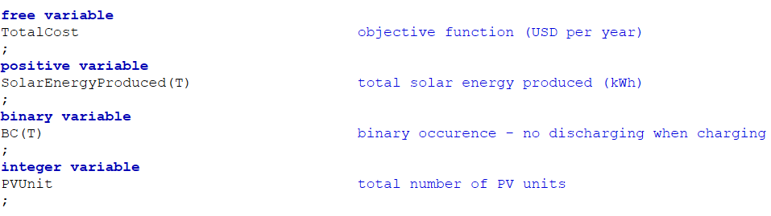
Important Syntax Features of GAMS
Variables
Variables are the “unknown” quantity in an optimization problem or the “outputs” that needs to calculated from the mathematical problem. There are several types of variables declaration in GAMS, such as free variable (usually the objective function), positive variable, binary variable, and integer variable. The default in GAMS is free variable.
Example
Free variable: Total system cost, total system emission
Positive variable: Electricity production rate, charging/discharging rate, fuel supply
Binary variable: Allowance to charge at certain hour, allowance to chose one technology from sets of technology
Integer variable: Number of PV units, number of turbine units, number of power plants
Example syntax

Slide 30
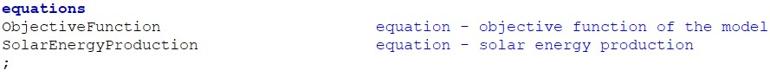
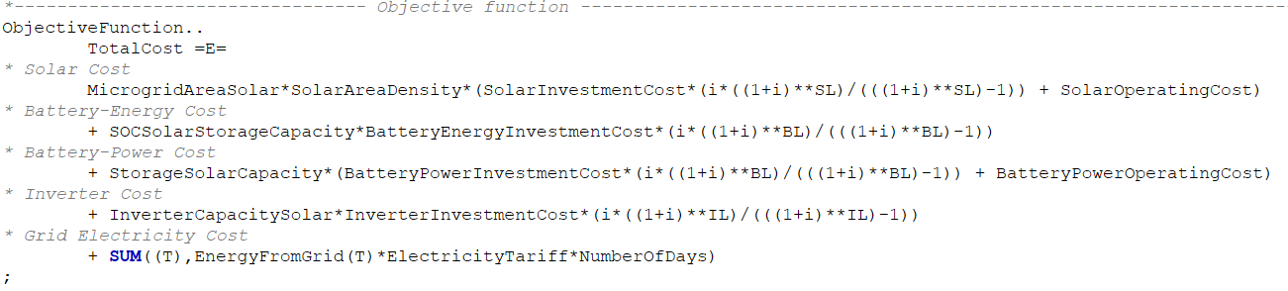
Important Syntax Features of GAMS
Equation list:
Representing the declaration of equation name.
Example syntax:
Equations: Equations that needs to be formulated to form an optimization model. Note: =E= reflects equal symbol, =L= reflects less than or equal symbol, =G= reflects greater than or equal symbol.
Example syntax:
To write comment, start with asterisk * (optional)
Double dot or .. is a must after an equation name
End each equation with semicolon ;

Slide 31
Important Syntax Features of GAMS
Model Statement: This syntax is used to name your optimization model and select the equations to be included in the modeling runs. Commonly, ALL equations are included to run the optimization model.
Example syntax:
Solve Statement: The solve statement (1) tells GAMS which model to solve, (2) selects the solver to use (in this case an LP solver), (3) indicates the direction of the optimization, either MINIMIZING or MAXIMIZING , and (4) specifies the objective variable.
Example syntax:

Slide 32
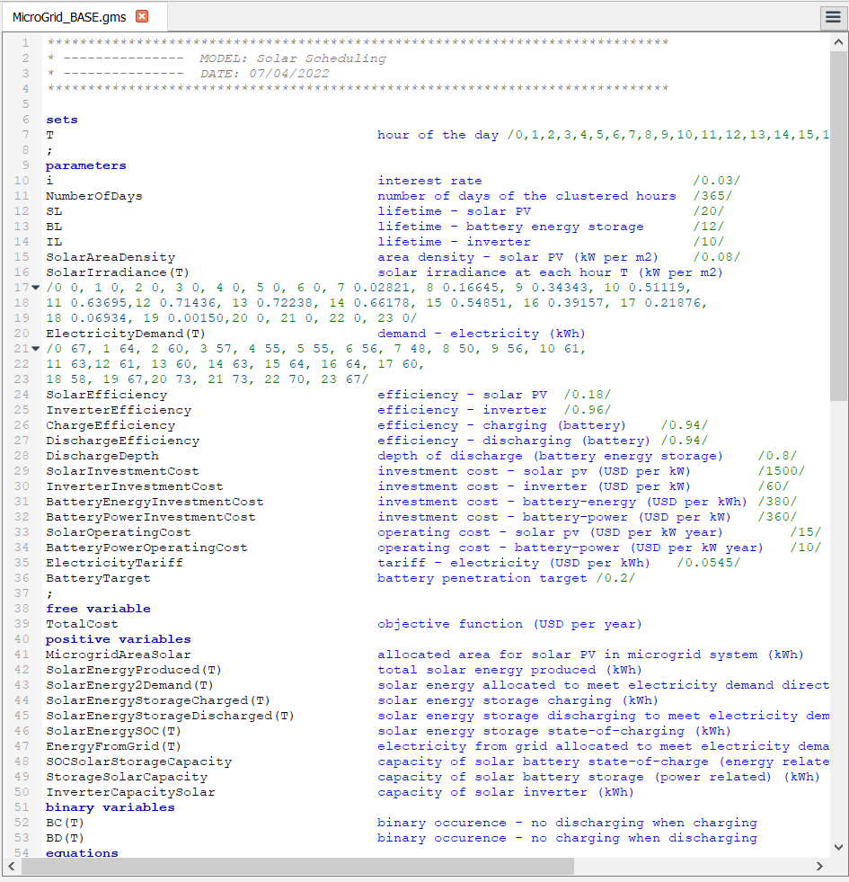
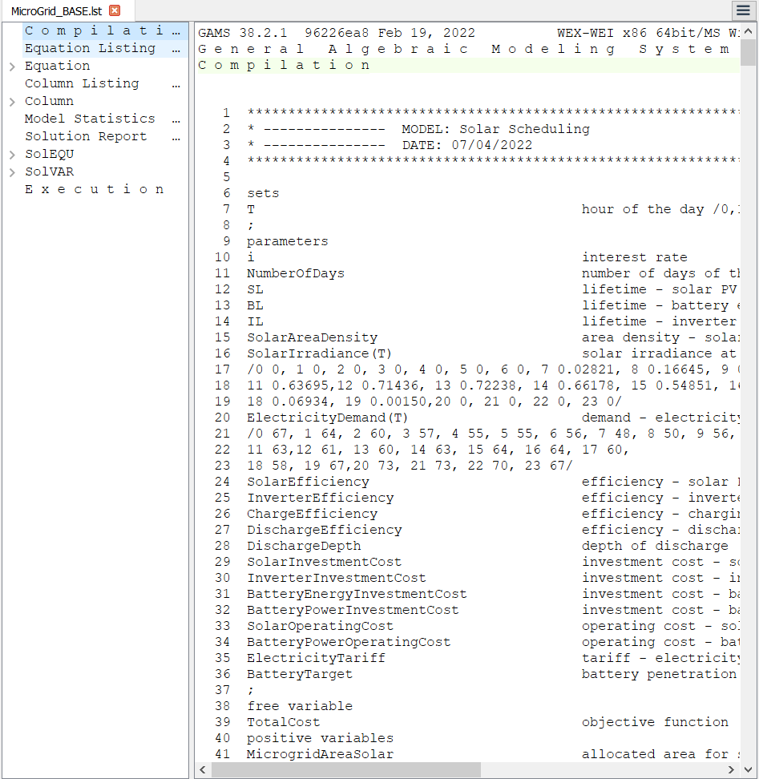
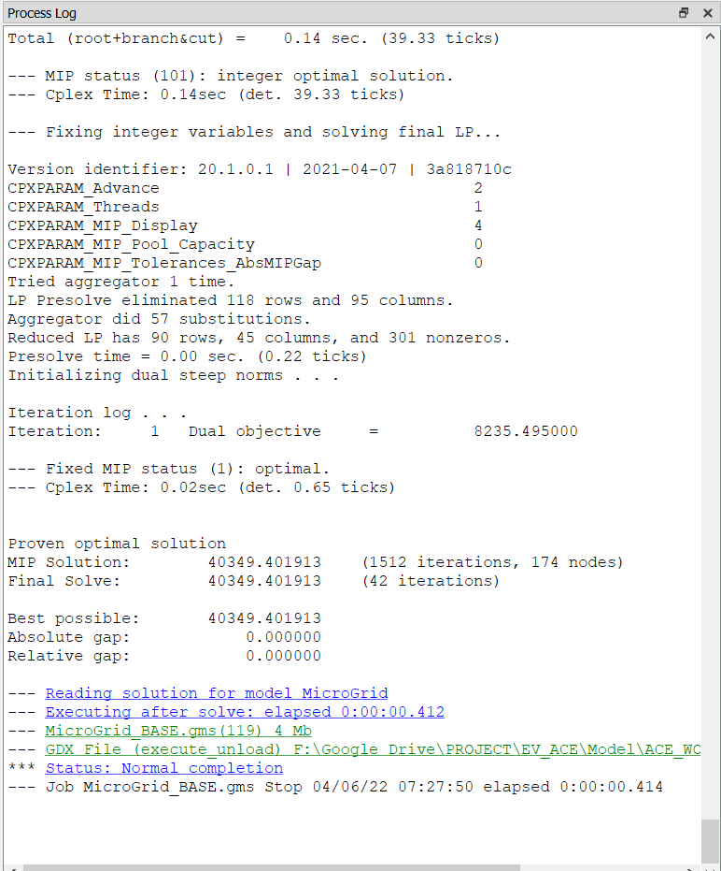
Important Files for Common GAMS Problem
ModelName.gms
- The file to be run containing all of the mathematical formulation syntax
ModelName.lst
- File containing the details of the modeling outputs
Process Log or ModelName.log
- Highlight the status of the model runs, objective function, errors, and key model settings.

Slide 33
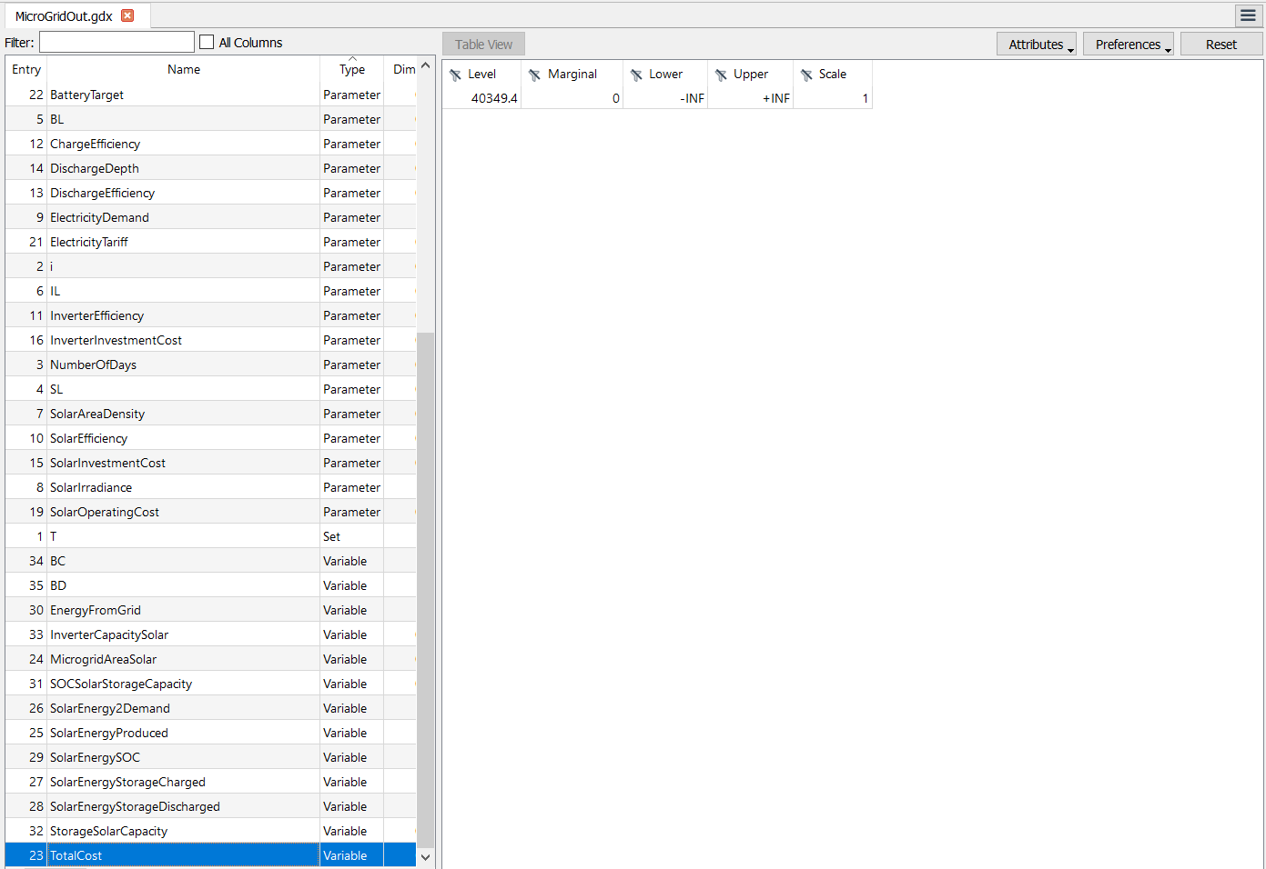
GDX File for Convenient Viewing of Modeling Outputs (Optional)
Additional syntax needs to be added in the model after the solve statement to compile all outputs in GDX file (a file compiling all the outputs in a tabular form).
Example syntax:

Slide 34
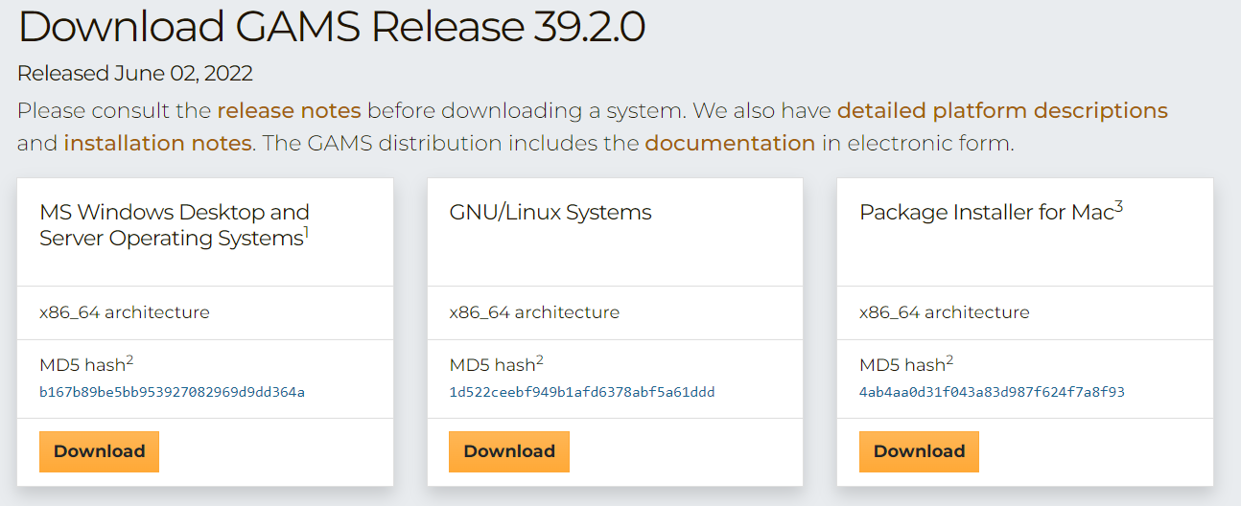
Steps to Install GAMS
Step 1: Please go the https://www.gams.com/try_gams/ and fill in your information to request a demo license. Please note that the demo license has limited functionality (It can handle a maximum of 2000 variables and 2000 constraints).
Step 2: Go to https://www.gams.com/download/, and download the latest version of GAMS software.
Step 3: Install GAMS. At the end of the installation process, there will be an instruction to upload the license file. If you miss the step to upload the license file, copy the information in the license file to your clipboard, open GAMS Studio, click Help>GAMS Licensing, and click yes on the instruction to upload the license file.
Step 4: Explore the GAMS software and run your models.

Slide 35
FORMULATION OF OPTIMISATION MODEL

Slide 36
GENERAL PROCEDURE TO FORMULATE AN OPTIMIZATION PROBLEM
STEP 1. DEFINE THE DECISION VARIABLES
STEP 2. DEFINE THE OBJECTIVE FUNCTION
STEP 3. DEVELOP PROCESS OR EQUIPMENT
MODEL USING PHYSICAL/EMPIRICAL
CORRELATION
- INCLUDE EQUALITY & INEQUALITY
CONSTRAINTS
STEP 4. APPLY SUITABLE SOLUTION TECHNIQUE
e.g graphical method vs optimization tools
STEP 5. PERFORM SENSITIVITY ANALYSIS
PROBLEM
FORMULATION
PROBLEM
SOLVING

Slide 37
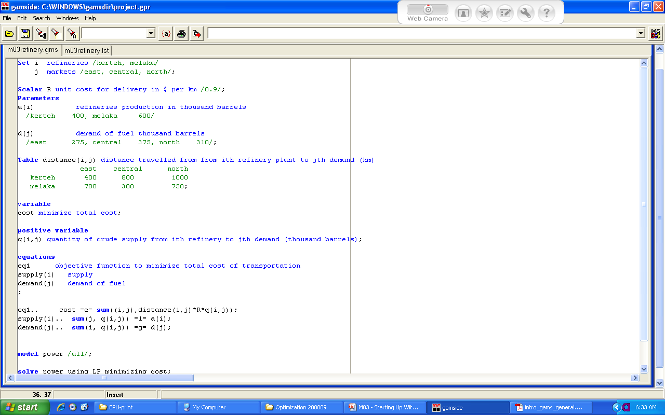
STEPS
SET definitions (refineries, markets)
2. Data entry
(cost, supply, demand)
3. Variable specifications
4. Equation declaration
5. Equation specification
5. Model statement
6. Solve statement
7. Display statement

Slide 38

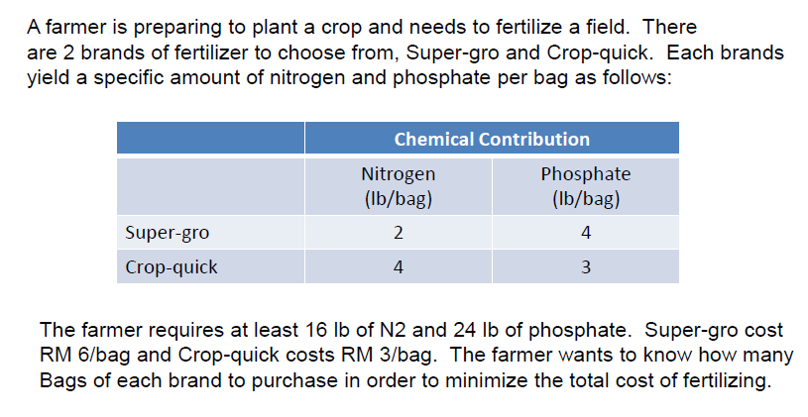
Fertilizer Example

Slide 39
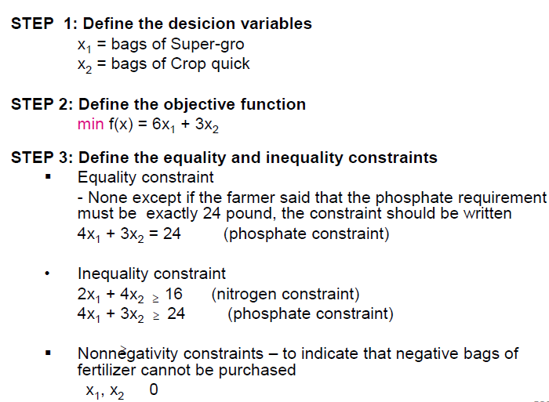
Formulation

Slide 40
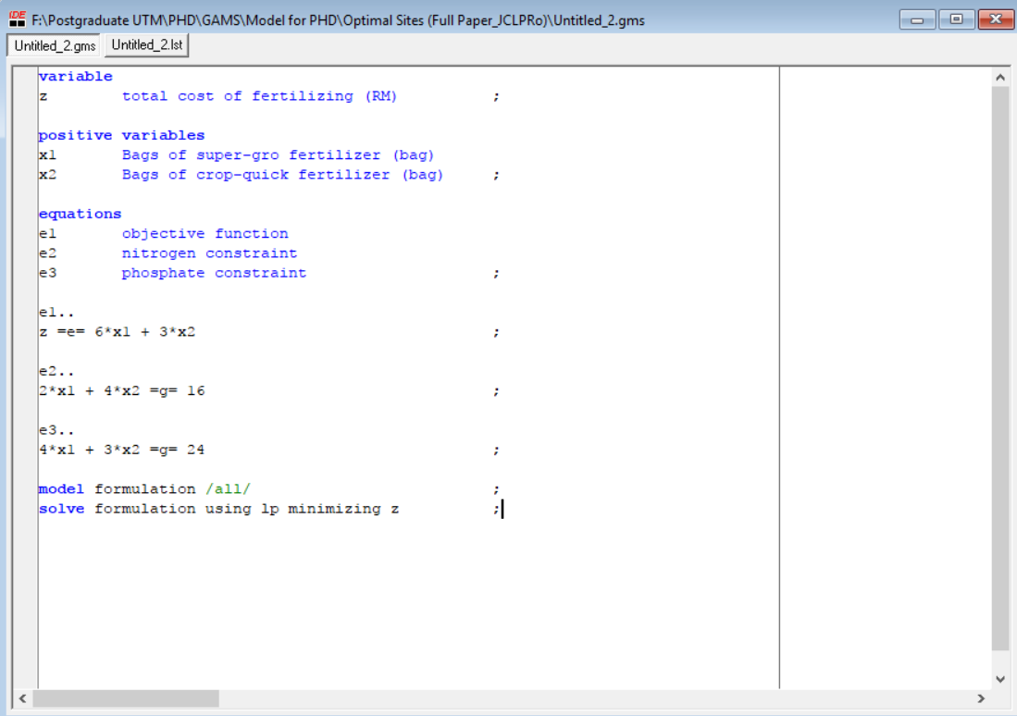
GAMS

Slide 41
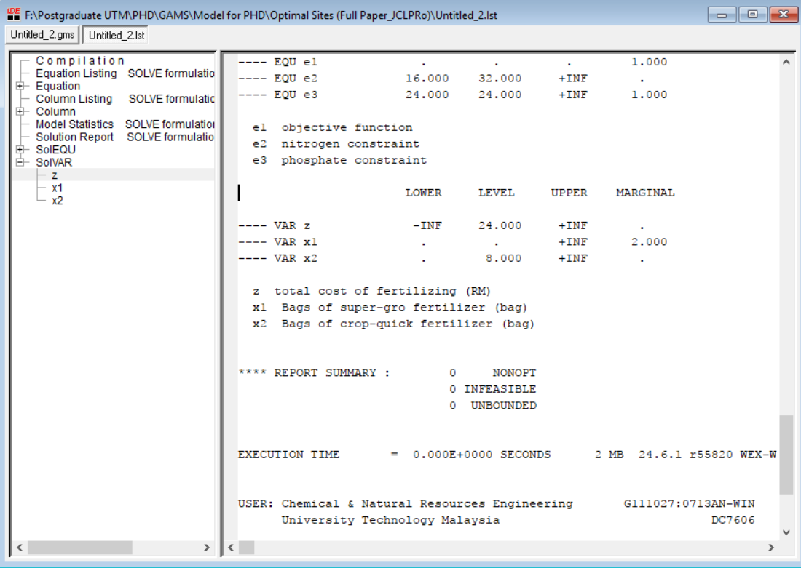
RESULT

Slide 42
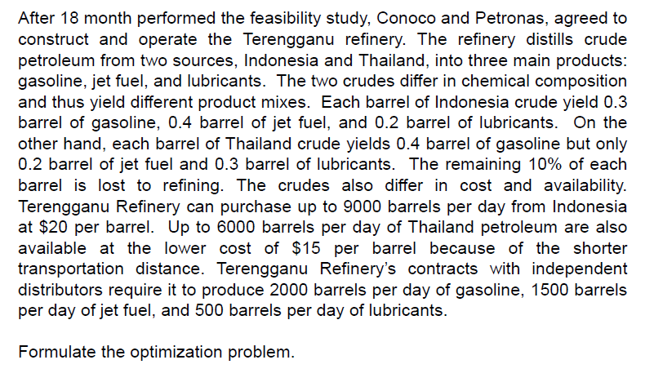
Two Crude Petroleum

Slide 43
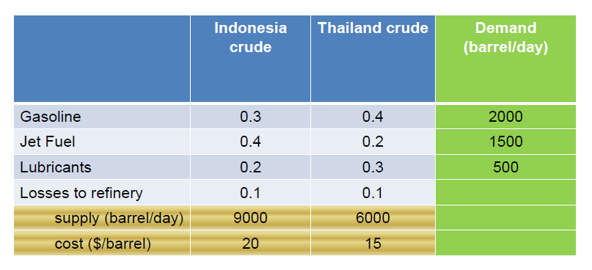
Two Crude Petroleum

Slide 44
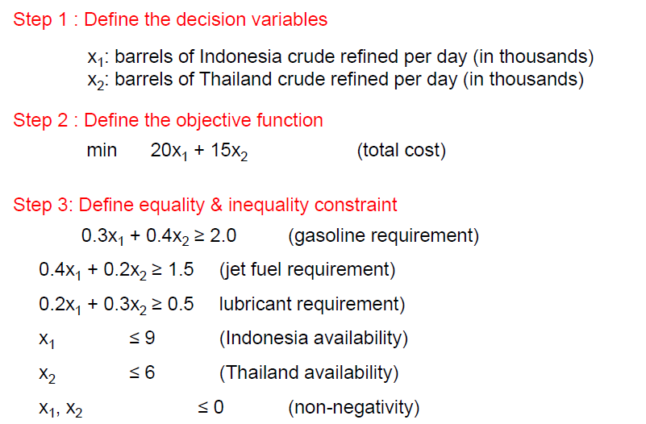
Formulation

Slide 45
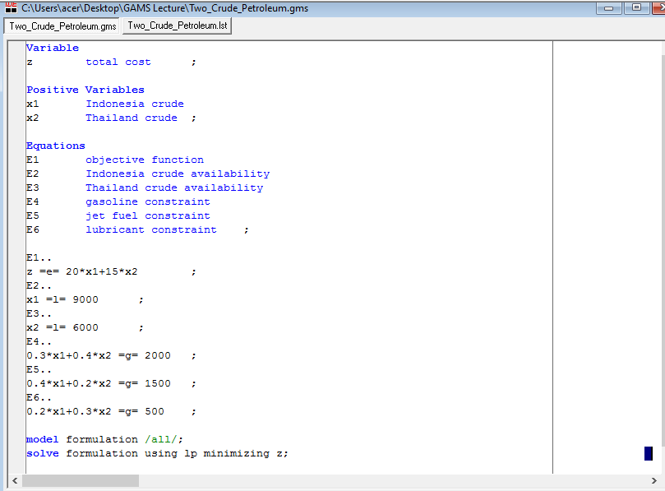
GAMS

Slide 46
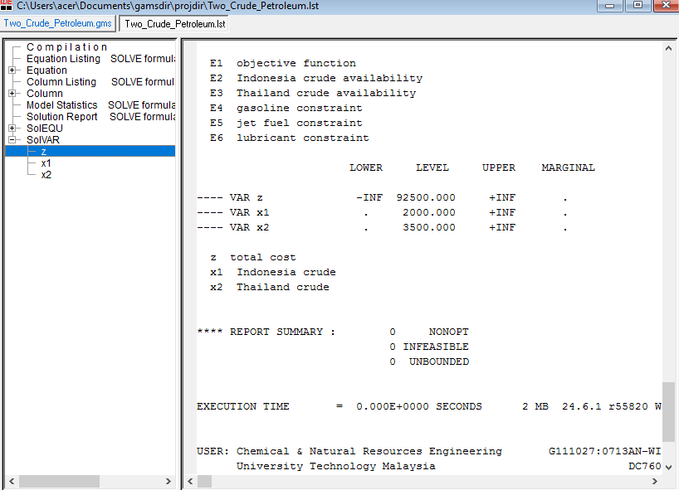
RESULT

Slide 47
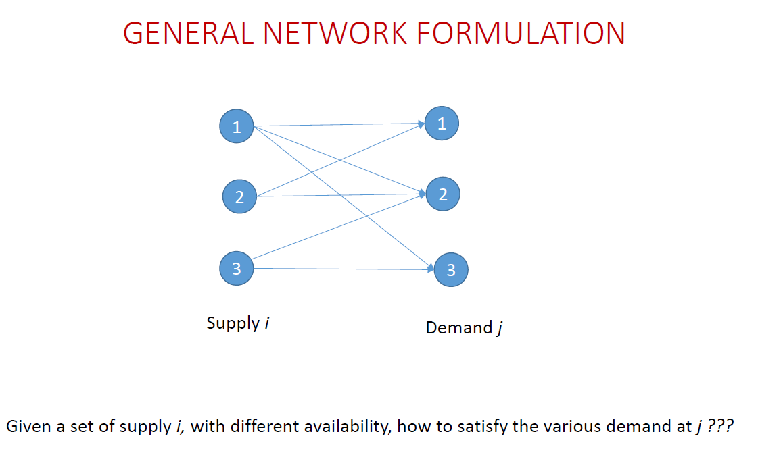
Introduction to Superstructure
Rule of thumb:
Availability ≥ Supply (Bounded)
Or
Availability ≥ Supply (Not Bounded)
Supply ≤ Demand (Bounded)
Or
Supply ≤ Demand (Bounded)

Slide 48
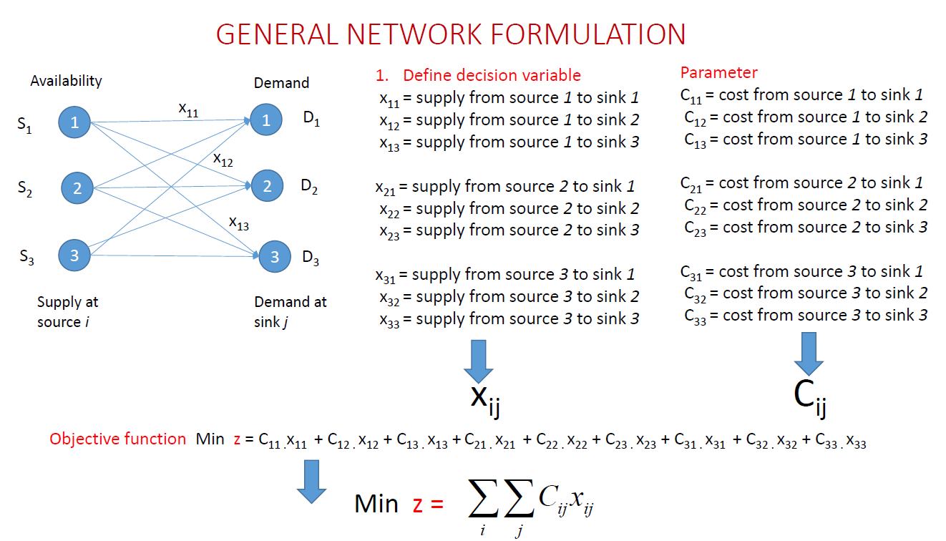
Introduction to Superstructure

Slide 49
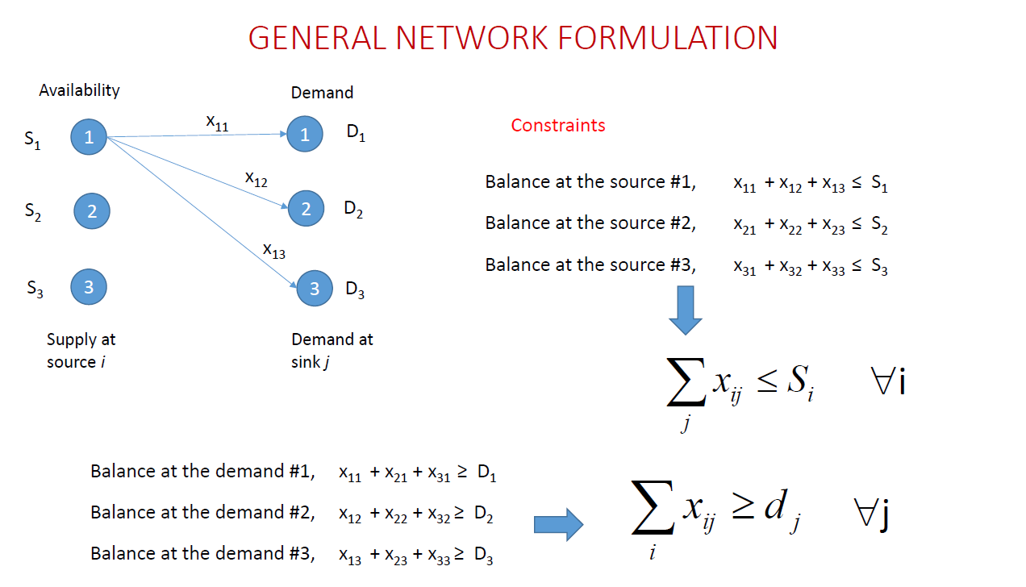
Introduction to Superstructure

Slide 50
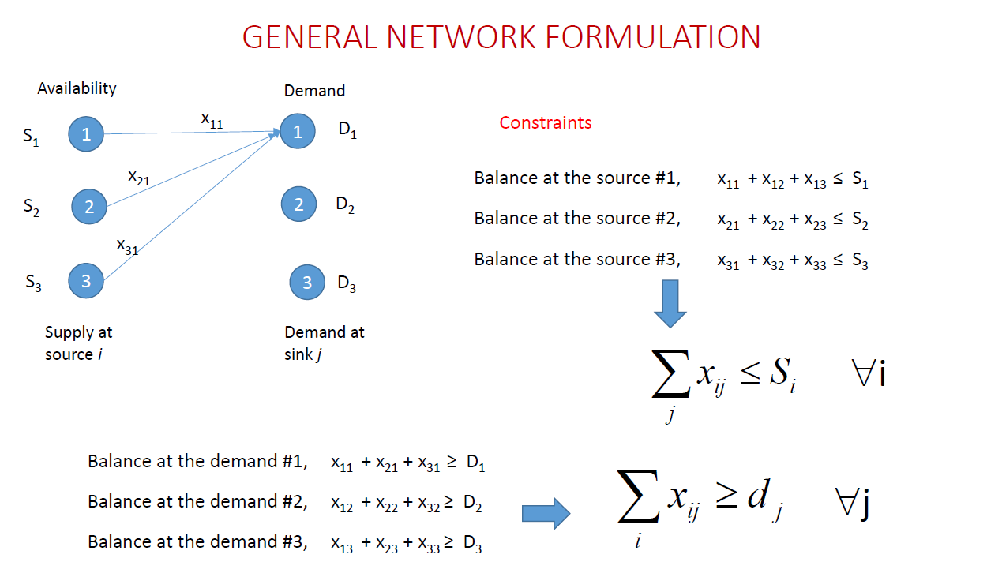
Introduction to Superstructure

Slide 51
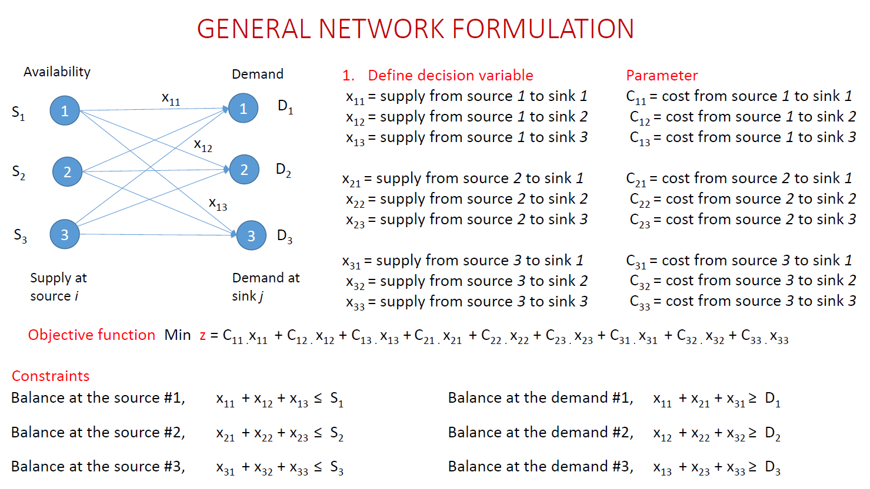
Introduction to Superstructure

Slide 52
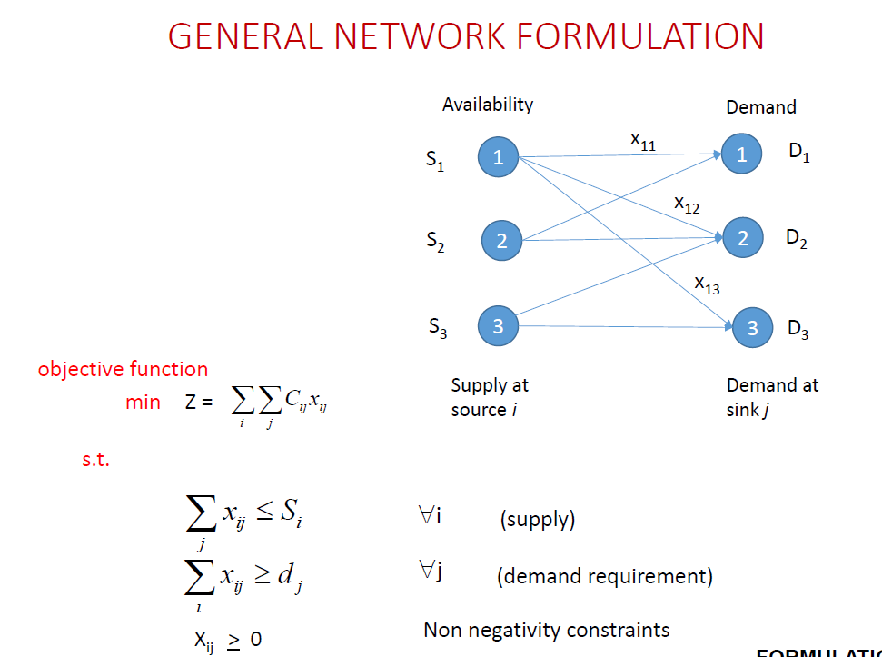
Introduction to Superstructure

Slide 53
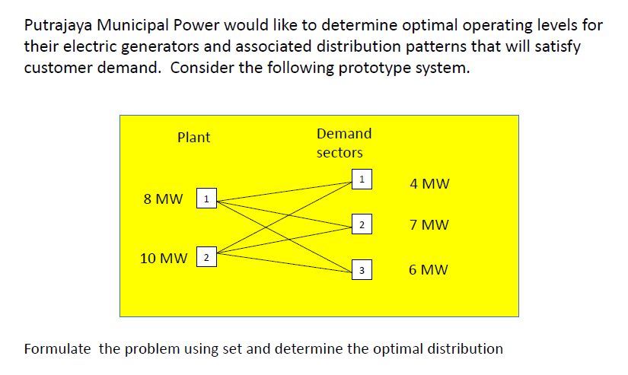
Power Distribution

Slide 54
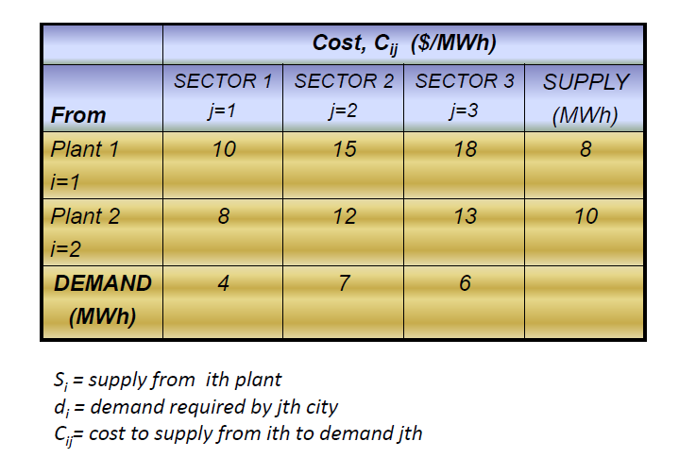
Power Distribution

Slide 55
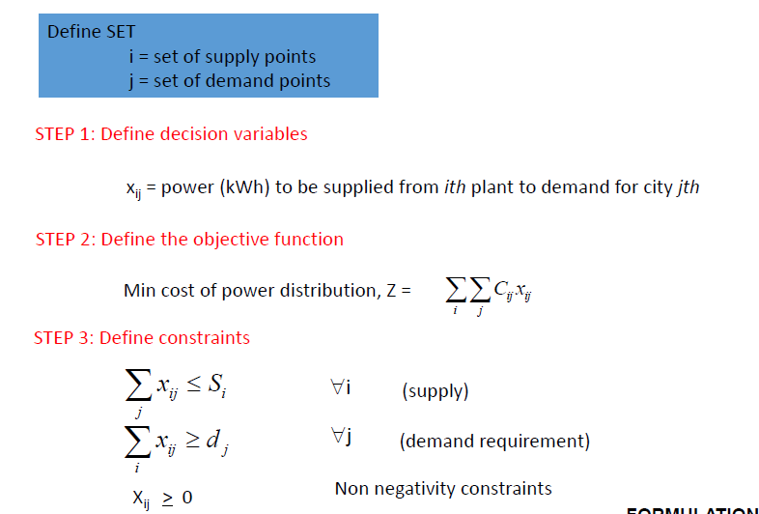
Formulation

Slide 56
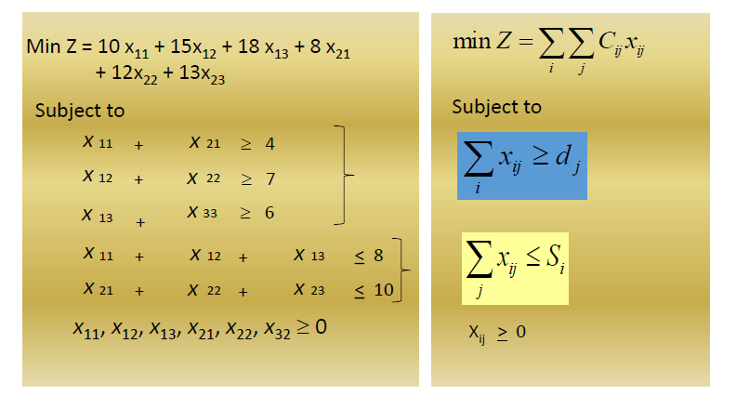
Formulation

Slide 57
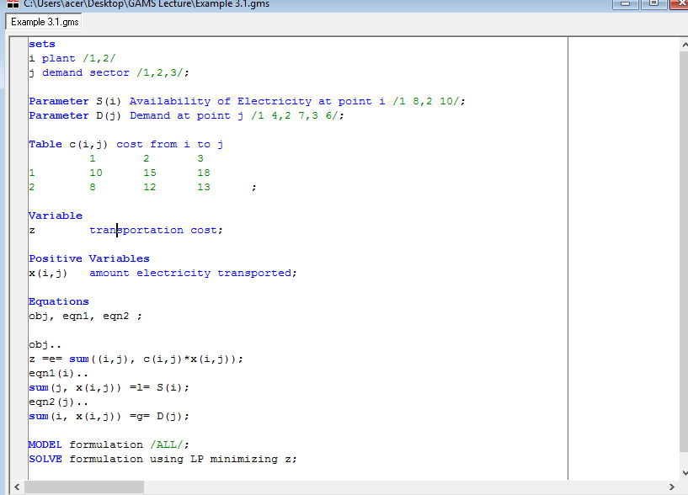
GAMS

Slide 58
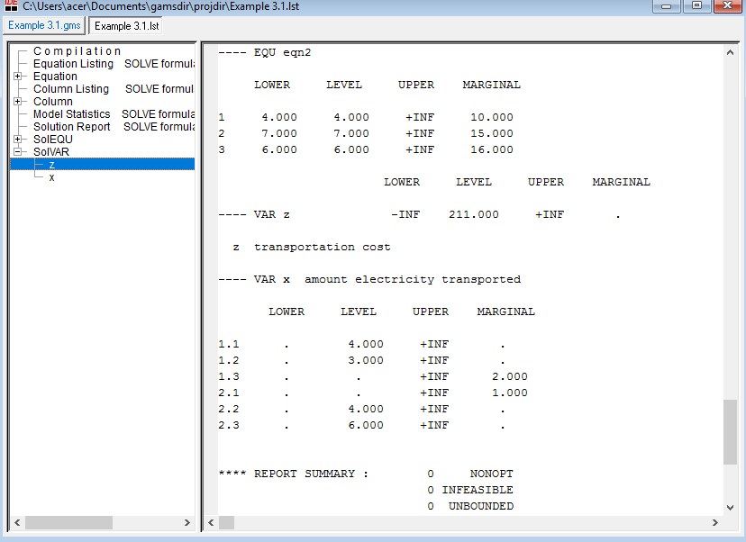
RESULT

Slide 59
OPTIMIZATION APPLICATION – SOLVING SCHEDULING PROBLEM

Slide 60
Importance of scheduling
Schedules are plans that state when certain controllable activities should take place
Schedules provide a coordination of activities to:
Increase productivity
Reduce operating costs
Identify resource conflicts
Ensure raw material is available
Standardize the production process etc.

Slide 61
Importance of scheduling
Schedule is generated
Operations begin
Schedule is followed as closely as possible
Achievement of program objectives

Slide 62
Roles of Scheduling in Planning Process
Short-term planning
Medium-term planning
Long-term planning

Slide 63
Roles of Scheduling in Planning Process
Short-term planning
Medium-term planning
Long-term planning
Covers a period of more than 1 year
E.g., 3-5 years
Objective: Set plan for future activities; set investment schedules
Covers a period of within one year
E.g., month, seasons
Objective: Set maintenance schedule; shutdown
Covers a period of 1 day to 1 week
E.g., minutes, hours, days
Objective: Hourly operations; Day-to-day scheduling

Slide 64
Roles of Scheduling in Planning Process
Short-term planning
Medium-term planning
Long-term planning
Covers a period of more than 1 year
E.g., 3-5 years
Objective: Set plan for future activities; set investment schedules
Covers a period of within one year
E.g., month, seasons
Objective: Set maintenance schedule; shutdown
Covers a period of 1 day to 1 week
E.g., minutes, hours, days
Objective: Hourly operations; Day-to-day scheduling

Slide 65
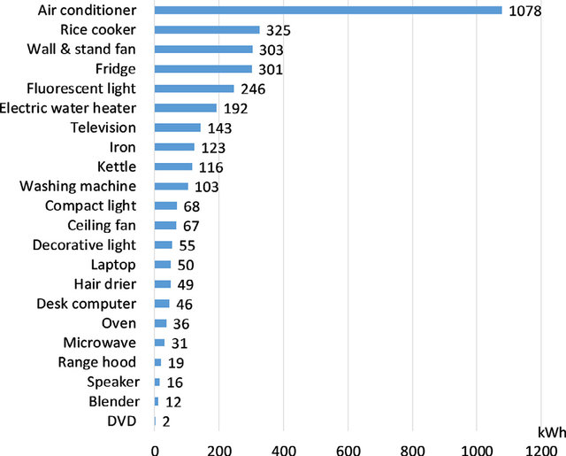
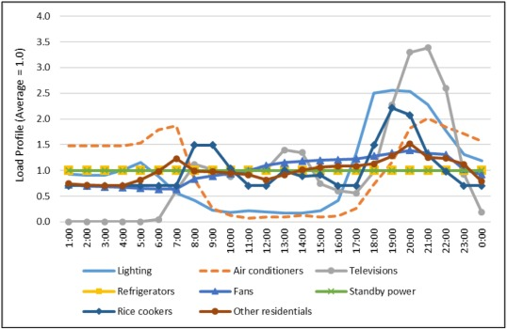
Scheduling Aspect in Electricity System: Daily electricity consumption by electrical appliances
Electricity Consumption by Electrical Appliances
Hourly Load Profiles of Electricity Consumption
Source: Le, V. T., & Pitts, A. (2019). A survey on electrical appliance use and energy consumption in Vietnamese households: Case study of Tuy Hoa city. Energy and Buildings, 197, 229-241.
Source: McNeil, M. A., Karali, N., & Letschert, V. (2019). Forecasting Indonesia's electricity load through 2030 and peak demand reductions from appliance and lighting efficiency. Energy for sustainable development, 49, 65-77.

Slide 66
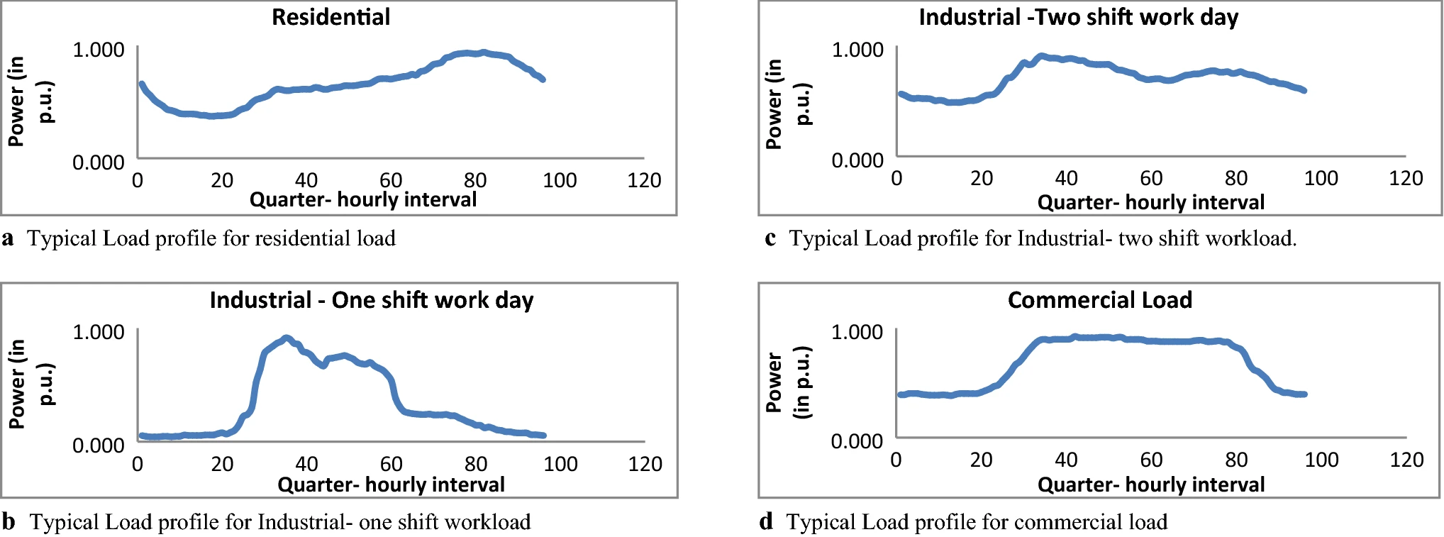
Scheduling Aspect in Electricity System: Different types of electricity load profiles
Source: Jain, A., Mani, A., & Siddiqui, A. S. (2019). Network architecture for demand response implementation in smart grid. International Journal of System Assurance Engineering and Management, 10(6), 1389-1402.

Slide 67
Scheduling Aspect in Electricity System: Power system operation
Generation must equal load plus transmission losses (about 5%)

Slide 68
Scheduling Aspect in Electricity System: Power system operation
What happens if a generator fails?
When load is greater than generation the system slows down
If nothing is done the system shuts down completely

Slide 69
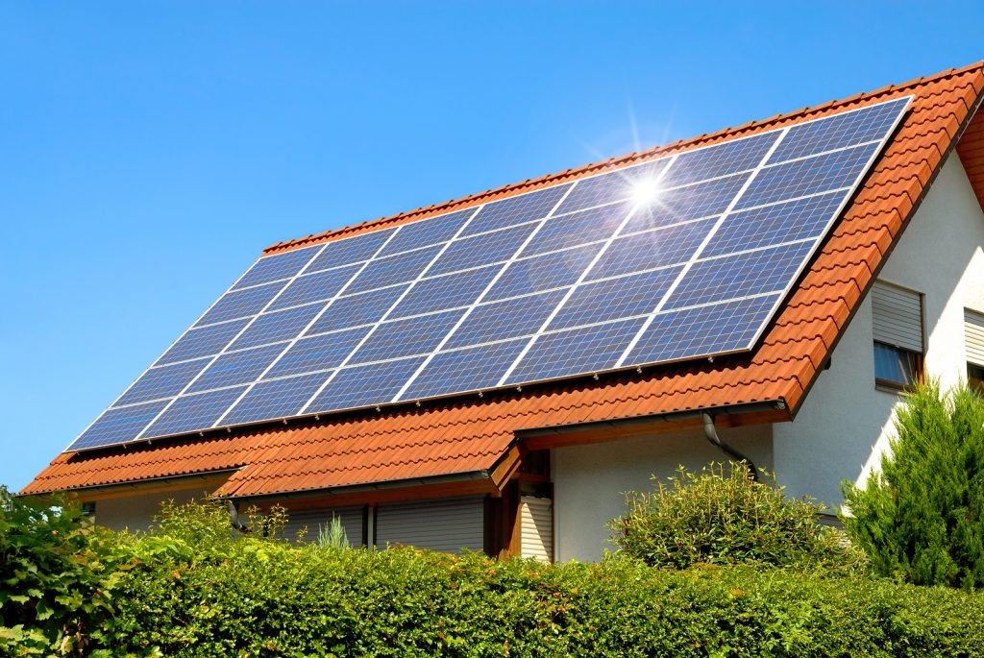
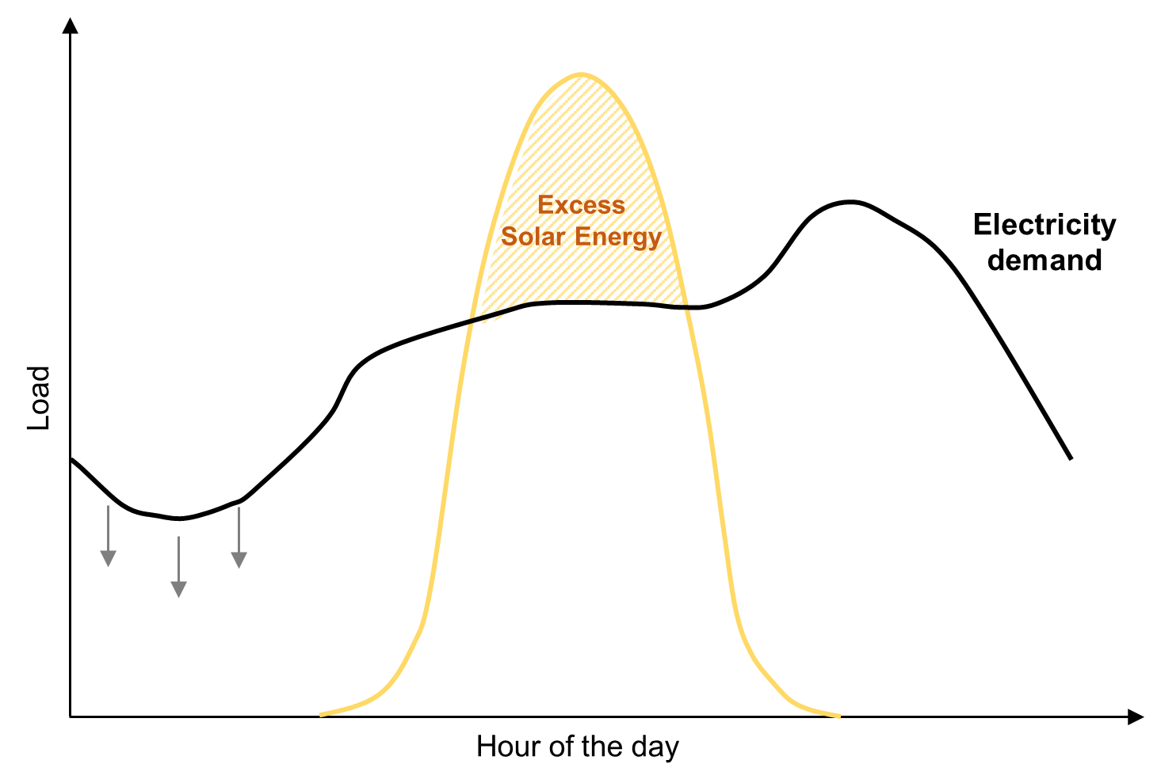
Scheduling Aspect in Electricity System: Solar PV Addition in Electrical Load

Slide 70
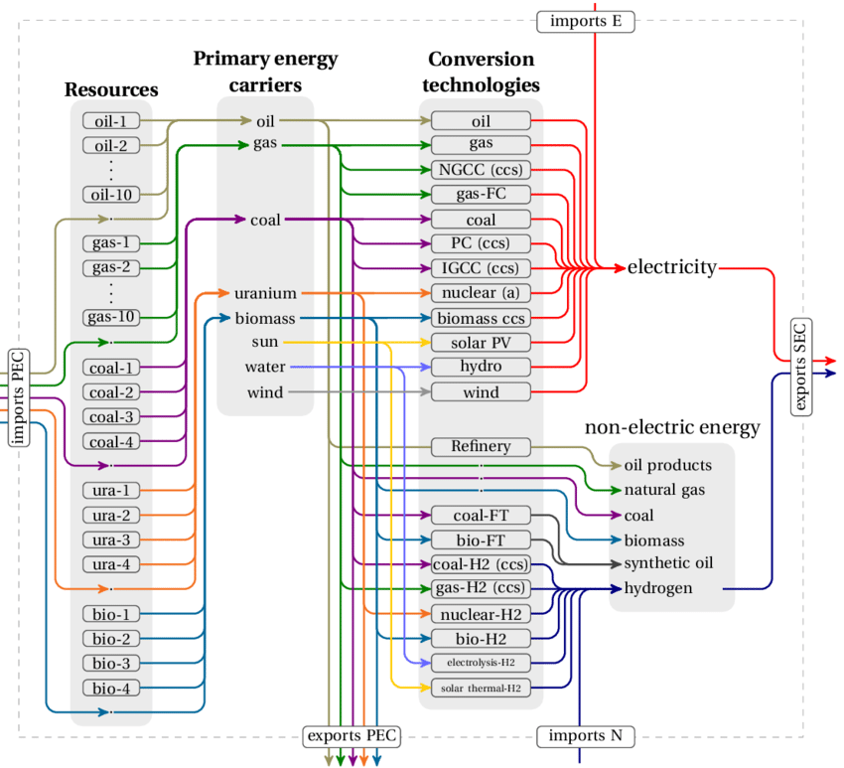

Source: Marcucci, A., & Turton, H. (2012). Swiss energy strategies under global climate change and nuclear policy uncertainty. Swiss journal of economics and statistics, 148(2), 317-345.
Source: Zappa, W., Junginger, M., & Van Den Broek, M. (2019). Is a 100% renewable European power system feasible by 2050?. Applied energy, 233, 1027-1050.

Slide 71
Exercise 1: Power system operation
Hour | Demand (MWh)
1 | 30
2 | 30
3 | 29
4 | 29
5 | 31
6 | 30
7 | 30
8 | 32
9 | 34
10 | 35
11 | 35
12 | 34
13 | 35
14 | 36
15 | 36
16 | 35
17 | 35
18 | 36
19 | 38
20 | 37
21 | 37
22 | 36
23 | 34
24 | 33
A power system operator receives an information that total coal and natural gas based electricity that are available for the next day operation are at 500 MWh and 2000 MWh per day, respectively, which cost at 40 USD/MWh and 50 USD/MWh. Given the electricity demand needed to be fulfilled at each hour, you are required to generate optimal scheduling operation for the power system operator at the lowest cost.

Slide 72
Exercise 1: Power system operation
Step 1: Define decision variables
x1(t) – coal-based electricity generation (MWh)
x2(t) – natural gas-based electricity generation (MWh)
Step 2: Define the objective function
Minimize cost = 40 * sum(t,x1(t)) + 50 * sum(t,x2(t))
Step 3: Define the equality and inequality constraints
Coal-based electricity availability:
sum(t,x1(t)) =l= a1;
Natural gas-based electricity availability:
sum(t,x2(t)) =l= a2;
Electricity demand
x1(t) + x2(t) =e= d1(t);

Slide 73

Exercise 1: GAMS Formulation

Slide 74

Exercise 1: GAMS Results
Natural Gas

Slide 75
Exercise 2: Power system operation
Hour | Demand (MWh)
1 | 30
2 | 30
3 | 29
4 | 29
5 | 31
6 | 30
7 | 30
8 | 32
9 | 34
10 | 35
11 | 35
12 | 34
13 | 35
14 | 36
15 | 36
16 | 35
17 | 35
18 | 36
19 | 38
20 | 37
21 | 37
22 | 36
23 | 34
24 | 33
A power system operator receives an information that total coal, natural gas, oil, nuclear, and hydropower based electricity that are available for the next day operation are at 200 MWh, 200 MWh, 100 MWh, 1000 MWh, and 100 MWh respectively, which cost at 40 USD/MWh, 50 USD/MWh, 35 USD/MWh, 60 USD/MWh, and 30 USD/MWh. Given the electricity demand needed to be fulfilled at each hour, you are required to generate optimal scheduling operation for the power system operator at the lowest cost.

Slide 76

Exercise 2: GAMS Formulation

Slide 77

Exercise 2: GAMS Results

Slide 78
Exercise 3: Power system operation
Hour | Demand (MWh) | Solar Electricity Availability (MWh)
1 | 30 | 0
2 | 30 | 0
3 | 29 | 0
4 | 29 | 0
5 | 31 | 0
6 | 30 | 0
7 | 30 | 2.4
8 | 32 | 8.4
9 | 34 | 15
10 | 35 | 20.8
11 | 35 | 24.9
12 | 34 | 26.9
13 | 35 | 26.6
14 | 36 | 23.9
15 | 36 | 19.2
16 | 35 | 13
17 | 35 | 6.5
18 | 36 | 1.3
19 | 38 | 0
20 | 37 | 0
21 | 37 | 0
22 | 36 | 0
23 | 34 | 0
24 | 33 | 0
A power system operator receives an information that total coal, natural gas, oil, nuclear, and hydropower based electricity that are available for the next day operation are at 100 MWh, 100 MWh, 100 MWh, 500 MWh, and 200 MWh respectively, which cost at 40 USD/MWh, 50 USD/MWh, 35 USD/MWh, 60 USD/MWh, and 30 USD/MWh. The operator wants to also integrate renewable energy in their operation based on solar which costs at 42 USD/MWh. Given the solar availability and electricity demand needed to be fulfilled at each hour, you are required to generate optimal scheduling operation for the power system operator at the lowest cost.

Slide 79

Exercise 3: GAMS Formulation

Slide 80

Exercise 3: GAMS Results

Slide 81
More concrete examples on scheduling
We will learn how to code the mathematical problem in GAMS and solve it to generate results.
Electricity scheduling problems are chosen as the cases to be studied in these exercises.
Three cases will be considered, namely Solar PV Integration, Solar PV Integration with Battery Storage, and Off-grid Solar PV Integration.
The objectives of evaluating the two cases include:
Evaluating the load profile pattern after the solar PV integration.
Identifying the costs of solar PV integration with and without battery storage contribution.
Identifying the scales of solar PV microgrid needed for the two cases.

Slide 82
Electricity Scheduling Problems: Solar PV Integration
Problem:
A group of residential customers are planning to install the Solar PVs in their houses. Previously, subscription of grid electricity to power their homes cost them a total of about USD 29,281.76/year of electricity bills. The customers want to know what are the maximum capacities of Solar PV that can be installed in their areas to save their electricity bills. Given this problem, you are requested to build a model to calculate optimal solar PV integration rate for cost savings of their houses based on a given parameter of a hourly electricity demand. Provided below are the related parameters that can be used for your calculation.
Input Data
Parameters | Parameters
Solar PV CAPEX: 1500 USD/kW | Solar PV lifetime: 20 years
Solar PV OPEX: 15 USD/kW/year | Inverter lifetime: 10 years
Inverter CAPEX: 60 USD/kW | Solar PV efficiency: 0.18
Electricity tariff: 0.0545 USD/kWh | Inverter efficiency: 0.96
Interest rate: 3% | Solar PV power density: 0.08 kW/m²

Slide 83
Electricity Scheduling Problems: Solar PV Integration
Input Data
Hour | Solar Irradiation (kW/m2) | Electricity Demand (kWh)
0 | 0 | 67
1 | 0 | 64
2 | 0 | 60
3 | 0 | 57
4 | 0 | 55
5 | 0 | 55
6 | 0 | 56
7 | 0.02821 | 48
8 | 0.16645 | 50
9 | 0.34343 | 56
10 | 0.51119 | 61
11 | 0.63695 | 63
12 | 0.71436 | 61
13 | 0.72238 | 60
14 | 0.66178 | 63
15 | 0.54851 | 64
16 | 0.39157 | 64
17 | 0.21876 | 60
18 | 0.06934 | 58
19 | 0.0015 | 67
20 | 0 | 73
21 | 0 | 73
22 | 0 | 70
23 | 0 | 67

Slide 84
Electricity Scheduling Problems: Solar PV Integration
Steps to Develop a Mathematical Model
Step 1: Define SET
T = set of hours in a day
Step 2: Define available PARAMETERS
SolarIrradiance_{T} = Solar Irradiation at hour T (kW/m²)
ElectricityDemand_{T} = Electricity demand at hour T (kWh)
SolarEfficiency = Efficiency of solar PV
InverterEfficiency = Efficiency of inverter to convert DC electricity from solar to AC
SolarAreaDensity = Solar PV power density (kW/m²)
ElectricityTariff = Electricity tariff (USD/kWh)
SolarInvestmentCost = Investment cost of solar PV (USD/kW)
SolarOperatingCost = Investment cost of solar PV (USD/kW/year)
InverterInvestmentCost = Investment cost of inverter (USD/kW)
i = Interest rate
SL = Solar PV lifetime (year)
IL = Inverter lifetime (year)
Step 3: Define DECISION VARIABLES
SolarEnergyProduced_{T} = Electricity generation from solar PV at hour T (kWh)
EnergyFromGrid_{T} = Electricity from the grid at hour T (kWh)
As solar irradiance parameter listed above is in kW/m², we need to convert it into kWh unit to ensure similar unit is being used for the energy balance. Thus, MicrogridAreaSolar in m² = Area needed for solar PV installation, is declared as a variable to cancel out the unit.
InverterCapacitySolar = Capacity of inverter (kW)

Slide 85


Electricity Scheduling Problems: Solar PV Integration
Steps to Develop a Mathematical Model
Step 4: Define OBJECTIVE FUNCTION
Minimize TotalCost of meeting electricity demand from solar PV and grid.
TotalCost = MicrogridAreaSolar x SolarAreaDensity x [SolarInvestmentCost * AnnualizedInvestmentFactorSolar + Operating Cost]
+ InverterCapacity x InverterInvestmentCost x AnnualizedInvestmentFactorInverter
+ $\sum_{T}{\text{EnergyFromGrid}\text{T}}$ x ElectricityTariff x 365
Step 5: Define CONSTRAINTS
Solar Energy Supply: SolarEnergyProduced_{T} = MicrogridAreaSolar x SolarIrradiance_{T} x SolarEfficiency $∀_{T}$
Electricity Demand: SolarEnergyProduced_{T} + EnergyFromGrid_{T} = ElectricityDemand_{T} $∀_{T}$
Inverter Capacity: SolarEnergyProduced_{T} ≤ InverterCapacity $∀_{T}$
Step 6: CODE the mathematical formulation in GAMS
Note:
Annualized Investment Factor =$\frac{i x (1 +i)Lifetime }{\left(1 +i\right)Lifetime−1}$
Where, i is interest rate, lifetime is the economic life of a technology

Slide 86

Electricity Scheduling Problems: Solar PV Integration
Sets and parameters

Slide 87

Electricity Scheduling Problems: Solar PV Integration
Declarations of variables and equations

Slide 88



Electricity Scheduling Problems: Solar PV Integration
Mathematical formulations
Model and solve statements

Slide 89
Electricity Scheduling Problems: Solar PV Integration
Results:
Objective function = 25,890.078161 USD/year
Microgrid area = 480.666 m²
Electricity production: 1,472 kWh/day (28% solar penetration)
Cost savings:
29,281.76 USD/year (Reference) – 25,890.078161 USD/year
= 3,391.68 USD/year
Load (kWh)
Hour | Grid Electricity | Solar PV
0 | 67 | 0
1 | 64 | 0
2 | 60 | 0
3 | 57 | 0
4 | 55 | 0
5 | 55 | 0
6 | 56 | 0
7 | 45.6569 | 2.343091
8 | 36.1749 | 13.82515
9 | 27.4751 | 28.52486
10 | 18.5412 | 42.45878
11 | 10.0957 | 52.90426
12 | 1.66613 | 59.33386
13 | 0 | 60
14 | 8.03336 | 54.96662
15 | 18.4414 | 45.55853
16 | 31.4767 | 32.52336
17 | 41.8301 | 18.16992
18 | 52.2407 | 5.759299
19 | 66.8754 | 0.124588
20 | 73 | 0
21 | 73 | 0
22 | 70 | 0
23 | 67 | 0
Please note to multiply SolarEnergyProduced_{T} with inverter efficiency in the results to reflect the converted electricity values.

Slide 90
Electricity Scheduling Problems: Solar PV Integration with Battery
Problem:
Similar case involving the fulfilment of electricity demand in residential areas is considered here. However, the customers are interested in enhancing the solar PV shares to power their homes. For this reason, battery energy storage is needed to store energy to increase the solar PV penetration at night. Based on this problem, you are requested to build a model to calculate optimal solar PV integration with battery contribution based on a given parameter of a hourly electricity demand (assuming 50% VRE penetration target, which is higher than the optimal rate in previous case at 28%, to force the battery contribution).
Note: Use the previous model and extend it for this application.
Additional Input Data
Parameters | Parameters
Battery-Energy CAPEX: 380 USD/kWh | VRE penetration target: 50%
Battery-Power CAPEX: 360 USD/kW | Battery lifetime: 10 years
Battery-Power OPEX: 10 USD/kW/year | Battery charging efficiency: 0.94
Battery depth-of-discharge: 80% | Battery discharging efficiency: 0.94

Slide 91

Electricity Scheduling Problems: Solar PV Integration with Battery
Sets and parameters

Slide 92

Electricity Scheduling Problems: Solar PV Integration with Battery
Declaration of variables and equations

Slide 93

Electricity Scheduling Problems: Solar PV Integration with Battery
Mathematical formulations

Slide 94

Electricity Scheduling Problems: Solar PV Integration with Battery
Mathematical formulations

Slide 95
Electricity Scheduling Problems: Solar PV Integration with Battery
Results:
Objective function = 35091.368572 USD/year
Microgrid area = 876.659 m²
Electricity production: 1,472 kWh/day (50% solar penetration)
Cost increment:
35,091.368572 USD/year - 29,281.76 USD/year (Reference)
= 5,809.61 USD/year
Load (kWh)
Hour | Grid Electricity | Solar PV | Battery
0 | 67 | 0 | 0
1 | 64 | 0 | 0
2 | 60 | 0 | 0
3 | 57 | 0 | 0
4 | 55 | 0 | 0
5 | 55 | 0 | 0
6 | 56 | 0 | 0
7 | 43.7266 | 4.27344 | 0
8 | 24.785 | 25.21498 | 0
9 | 3.97491 | 52.02509 | 0
10 | 0 | 61.00003 | 0
11 | 0 | 63 | 0
12 | 0 | 61.00003 | 0
13 | 0 | 60 | 0
14 | 0 | 63 | 0
15 | 0 | 64.00003 | 0
16 | 4.68234 | 59.31763 | 0
17 | 26.8608 | 33.1392 | 0
18 | 47.4959 | 10.50413 | 0
19 | 66.7728 | 0.22723 | 0
20 | 33.0971 | 0 | 39.90286
21 | 26.5349 | 0 | 46.46512
22 | 23.5349 | 0 | 46.46512
23 | 20.5349 | 0 | 46.46512
Please note to multiply SolarEnergyProduced_{T} with inverter efficiency and SolarEnergyStorageDischarged_{T} with inverter efficiency and discharge efficiency in the results to reflect the converted electricity values.

Slide 96
Electricity Scheduling Problems: Off-Grid Solar PV Integration
Problem:
For this problem, you are requested to apply the previous model (Solar PV Integration with Battery) to assess off-grid solar PV integration with battery based on a given parameter of a hourly electricity demand (assuming 100% VRE penetration target to resemble the off-grid application).
Note: Use the previous model and extend it for this application.

Slide 97
Electricity Scheduling Problems: Off-Grid Solar PV Integration
Results:
Objective function = 69,922.459796 USD/year
Microgrid area = 1,826.32 m²
Electricity production: 1,472 kWh/day (100% solar penetration)
Cost increment:
69,922.45979 USD/year - 29,281.76 USD/year (Reference)
= 40,640.70 USD/year
Load (kWh)
Hour | Grid Electricity | Solar PV | Battery
0 | 0 | 0 | 67.00004
1 | 0 | 0 | 64.00001
2 | 0 | 0 | 60.00003
3 | 0 | 0 | 57.00001
4 | 0 | 0 | 55.00002
5 | 0 | 0 | 55.00002
6 | 0 | 0 | 55.99997
7 | 0 | 8.902723 | 39.09729
8 | 0 | 49.99997 | 0
9 | 0 | 55.99997 | 0
10 | 0 | 61.00003 | 0
11 | 0 | 63 | 0
12 | 0 | 61.00003 | 0
13 | 0 | 60 | 0
14 | 0 | 63 | 0
15 | 0 | 64.00003 | 0
16 | 0 | 64.00003 | 0
17 | 0 | 60 | 0
18 | 0 | 21.88282 | 36.11721
19 | 0 | 0.473381 | 66.52664
20 | 0 | 0 | 73.00001
21 | 0 | 0 | 73.00001
22 | 0 | 0 | 69.99998
23 | 0 | 0 | 67.00004
Please note to multiply SolarEnergyProduced_{T} with inverter efficiency and SolarEnergyStorageDischarged_{T} with inverter efficiency and discharge efficiency in the results to reflect the converted electricity values.

Slide 98

Advanced Functionality: Data Exchange with Microsoft Excel
Data Exchange in GAMS using Excel as an interface
Input
Output

Slide 99

Advanced Functionality: Data Exchange with Microsoft Excel
Using the first case, Solar PV Integration, we can transform the model into using excel as an interface by modifying the declaration of input and output data.
Previous codes
Added codes
Data previously inputted in GAMS needs to be removed

Slide 100
Advanced Functionality: Data Exchange with Microsoft Excel
Added codes (enlarged)
Put the name of your excel input data.
Put the name of the first sheet of your excel
To call set and parameters from the excel

Slide 101

Advanced Functionality: Data Exchange with Microsoft Excel
Using the first case, Solar PV Integration, we can transform the model into using excel as an interface by modifying the declaration of input and output data.
Previous codes
Added codes
Put the name of your excel output data.
Put the name of the first sheet of your excel

Slide 102


Advanced Functionality: Data Exchange with Microsoft Excel
Horizontal Dimension,
1 reflect only 1 row of horizontal dimension related to data categorized using set
No Dimension, meaning the data is called as it is at its predefined position
Excel Input
Vertical Dimension
Calling the data from the pre-defined position in the same excel
Users need to define the position of data in the first sheet of excel (name of sheet is user-defined). The first column reflects the data type, whether set or par (parameter). The second column reflects the name of the input data declared in GAMS. The third column reflects the position of data in Excel.

Slide 103


Advanced Functionality: Data Exchange with Microsoft Excel
Horizontal Dimension,
1 reflect only 1 row of horizontal dimension related to data categorized using set
No Dimension, meaning the data is called as it is at its predefined position
Excel Output
Vertical Dimension
Reflect the position of output data in the same excel
Users need to define the position of data in the first sheet of excel (name of sheet is user-defined). The first column reflects the data type, whether set or par (parameter) or var (variable). The second column reflects the name of the input data declared in GAMS. The third column reflects the position of data in Excel.

Slide 104
Further Readings
GAMS’s User’s Guide at https://www.gams.com/latest/docs/UG_MAIN.html
GAMS World Forum at https://forum.gamsworld.org/
GAMS’s case studies https://www.gams.com/stories/
GAMS MIRO https://www.gams.com/sales/miro_facts/
GAMS Engine https://www.gams.com/engine/installation.html
To view a library of previous models coded in GAMS from other authors, open GAMS Studio>GAMS>Model Library Explorer

